Slide 1
Harold Cannady & Allene Finley
Do you need a subscription to Ancestry.com to do your research?

Slide 2
What I know about the grandparents
grandfather Harold Cannady, approximately 1897 to 1948
married to Allene (Finley) Cannady and lived in Niles, Mi.
He may have died in the Detroit area but I can't find anything.

Slide 3
What I want to know…
Who was he and where is he buried?
Where are his blood relatives?
Did he kill Allene? (Rumor).
If Allene's mother was Martha (Mattie) Curtiss, who was she?
What was their race and where did they come from?

Slide 4
Background Information: are we ready to answer that question?
Research questions are always based on the information you have. So first, gather basic information.
Census records
Birth, marriage death records
Other information readily available online
  Use Ancestry.com?

Slide 5
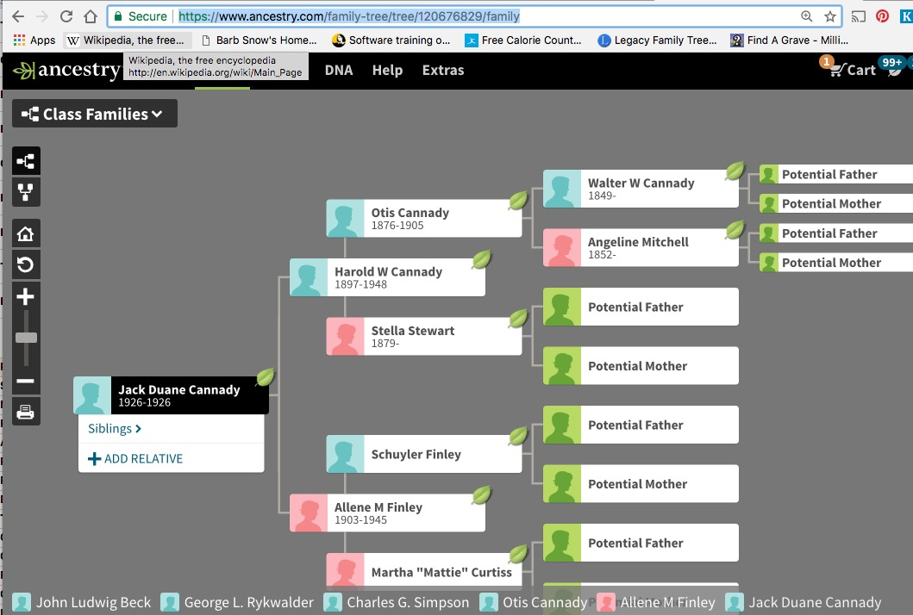
Using Ancestry
https://www.ancestry.com/family-tree/tree/120676829/family

Slide 6
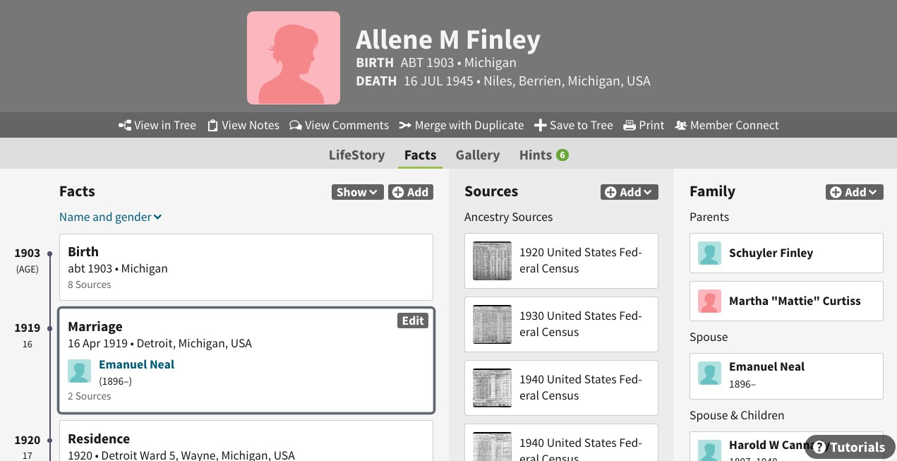
I found many records for the two grandparents

Slide 7
Some of what I learned
Each had been married prior to their marriage.
They married 27 June 1922 in Toledo.
1930 they are living in Niles, Michigan with children.
1940 Allene is in Niles with children; Harold is living with his parents in Detroit.
The divorced in 1941 (newspapers.com)
Harold remarried; Allene evidently did not.
Allene died in Niles, 16 July 1945
Harold died in Highland Park, 16 June 1948

Slide 8
So Did Harold murder Allene ?
Let’s find her death record to learn the cause of death.
Michigan death records are indexed at FamilySearch.org; some images available
Michigan Death Records are available at Seeking Michigan
  Problematic search engine; use FamilySearch index first
  Other Michigan records are also at that site

Slide 9
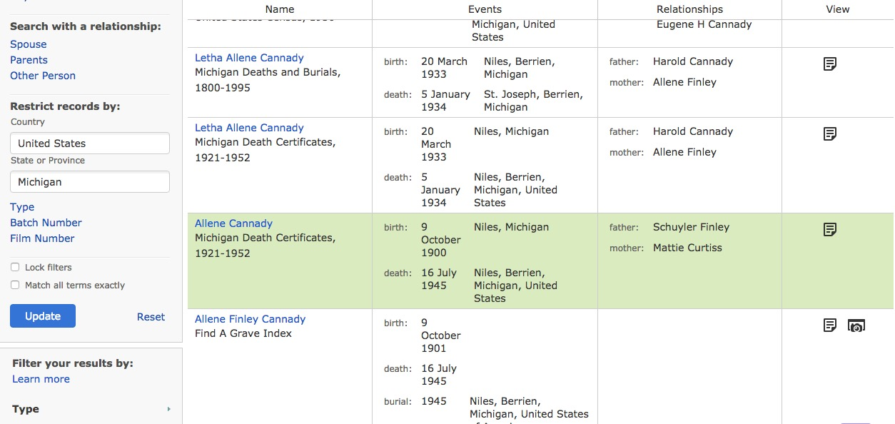
FamilySearch.org Results:
Allene Cannady, Michigan

Slide 10
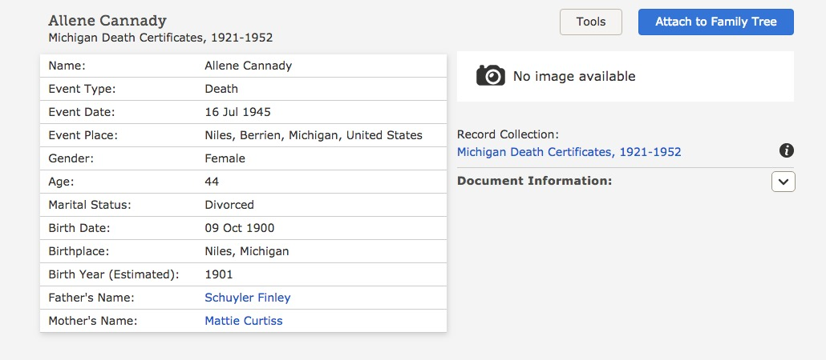
Here is index/abstract; no image
We need to see the certificate
to learn cause of death

Slide 11
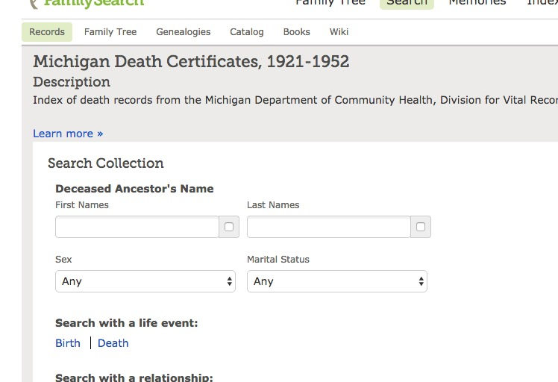
Here is the search box for the collection
So small, but so helpful

Slide 12
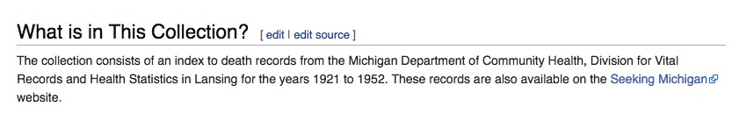
These records are also available on Seeking Michigan

Slide 13
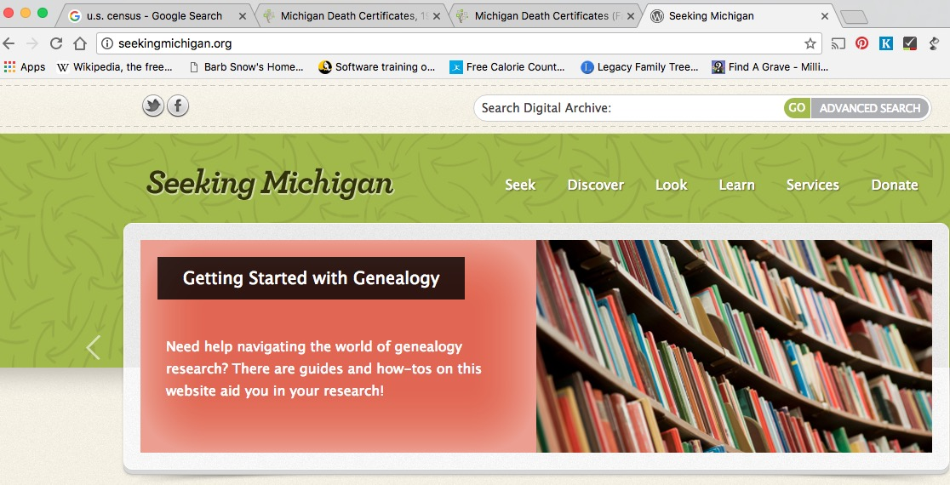
http://seekingmichigan.org

Slide 14
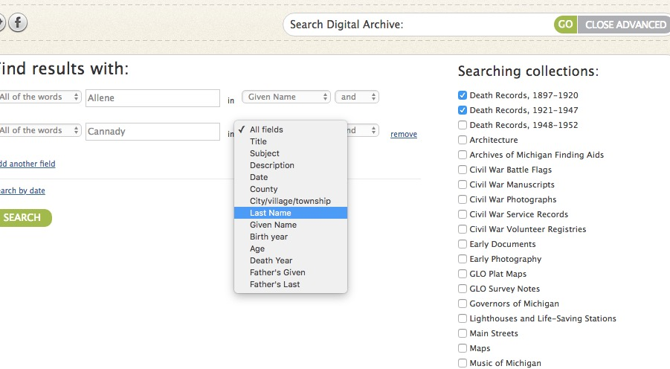
Advanced search
Check the first choice even if the dates aren’t
what you need. Otherwise you don’t get the
correct search options.

Slide 15
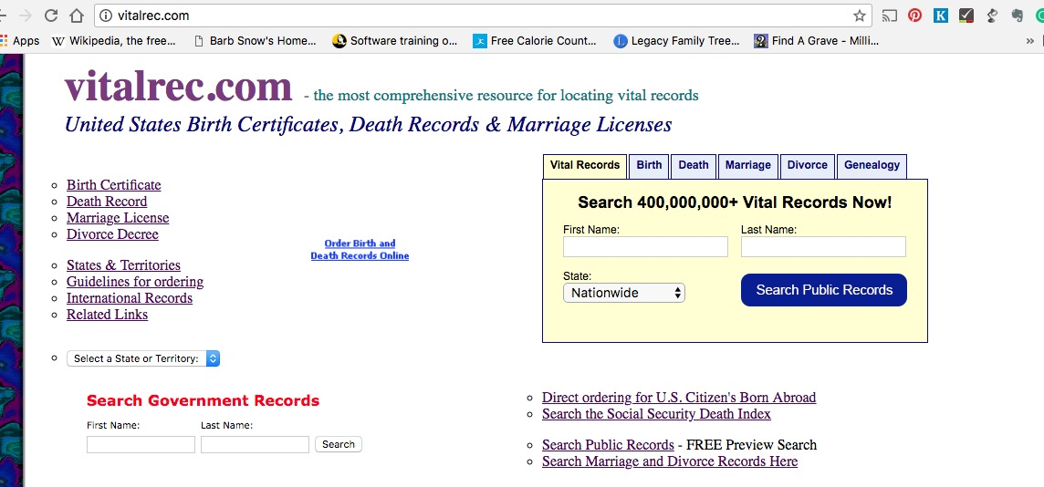
Vitalrec.com is a helpful site
Never mind what is at the top of the page; scroll down

Slide 16
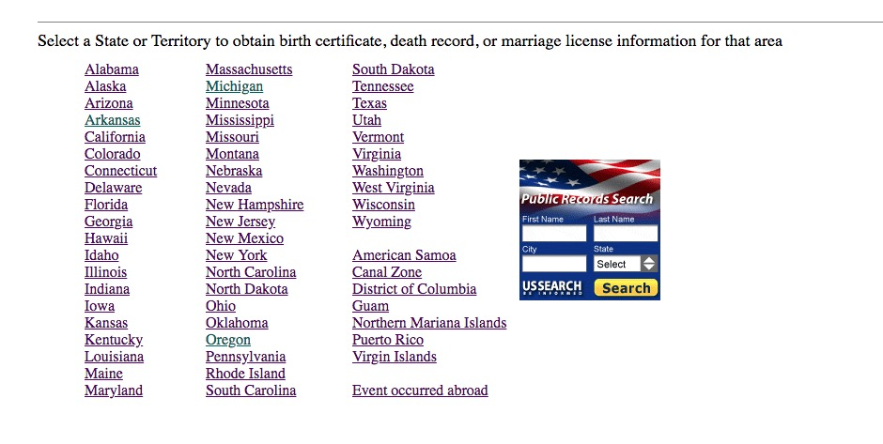
When you get here, select the state.

Slide 17
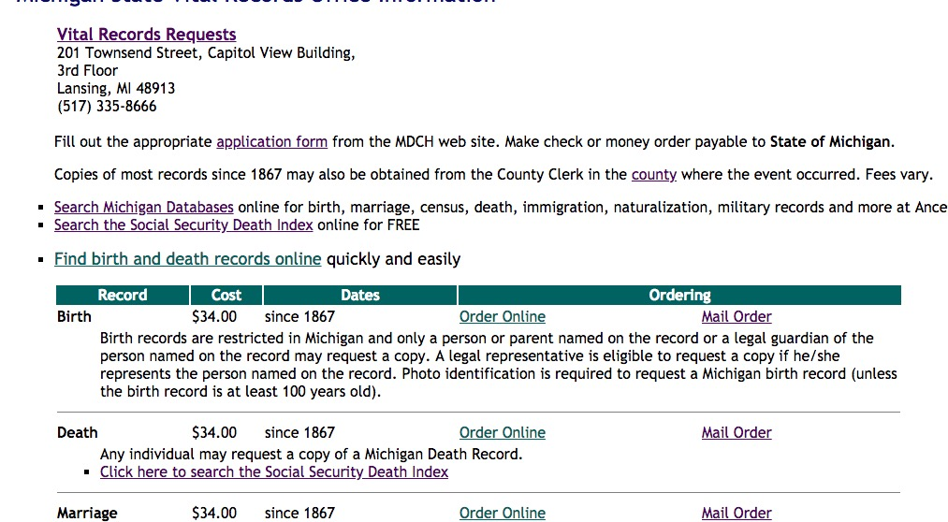
This tells you how to get records from the state

Slide 18
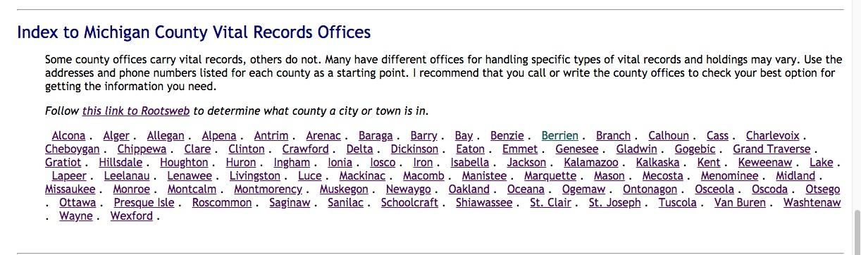
Scroll down to a list of counties
Select the county you want

Slide 19
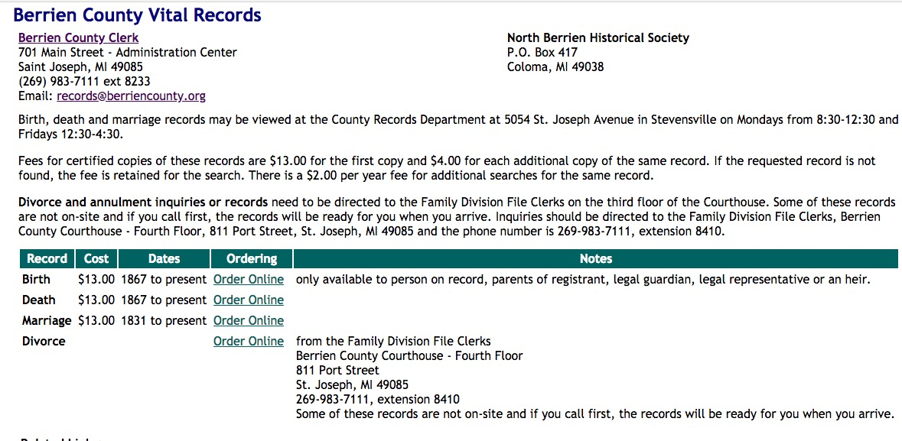
This tells you how to get information from the county

Slide 20
Cause of death
If you get record from state or county, you may get a transcript or abstract, not an image
of the original record
Be sure you specify you need to know cause of death!
If it seems mysterious, start looking for a coroner’s record! And newspaper articles

Slide 21
Can you create a tree on Ancestry.com without a subscription?
Yes
  Sign up for free account
  You can’t search the records from it.
  You can’t attach records from Ancestry to it.
  You don’t get hints to check (the green leaves)
  You can upload your own records, images, etc.
  You can create stories on it
  Other people can find it and contact you
  You can also search other people’s trees

Slide 22
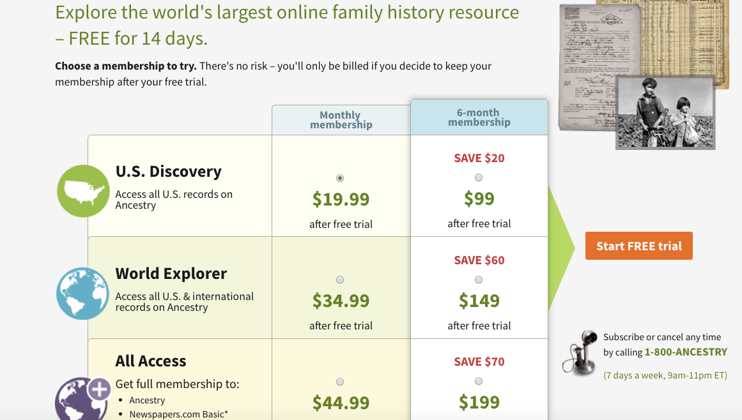
Ancestry.com
Notice price
is for 6 mo.
If you want don’t want to subscribe, be sure to cancel before the deadline.

Slide 23
Remember:
U.S. Census records are available on Heritage Quest (free through mel.org)
Familysearch.org has a huge number of birth, marriage and death records; most indexed.
And both sites have other very large, very useful
collections. And there are other free sites.

Slide 24
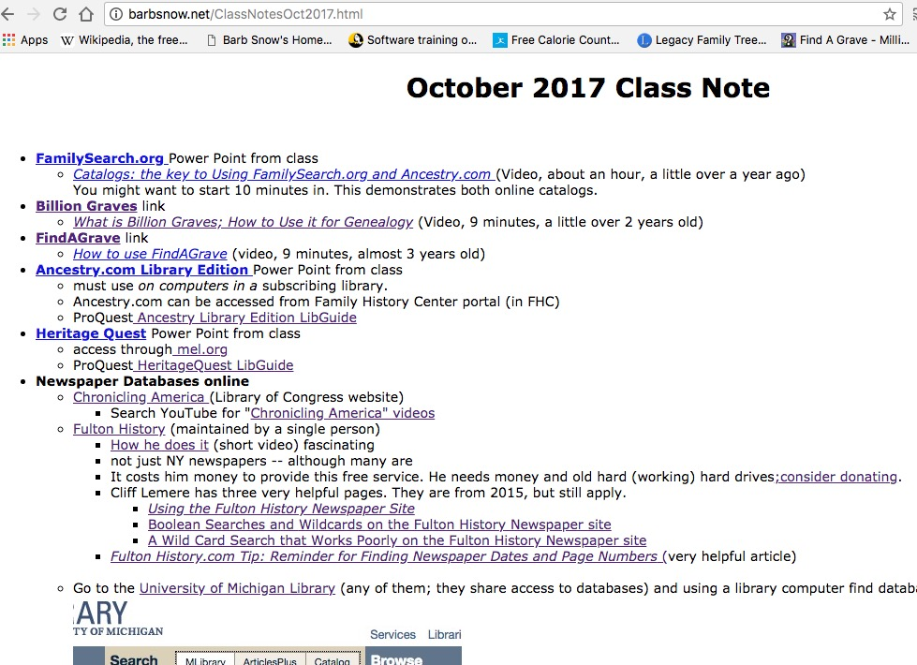
See Oct. 2017 PowerPoints & Links http://barbsnow.net/ClassNotesOct2017.html

Slide 25
Join a local society where you live
http://www.washtenawgenealogy.org
$13 a year – but can attend meetings free
Get to know other genealogists
Hear interesting talks at monthly meetings
  Participate in helpful after-talk classes
Participate in SIGs /start a SIG
  (DNA SIG now currently active)
Access to members-only part of website
Be an active member of the society – volunteer for activities, committees etc.

Slide 26
Other Michigan Genealogical Societies
Detroit
  Detroit Society for Genealogical https://dsgr.org/
  Fred Hart Williams Genealogical Society http://fhwgs.org/
  Irish Genealogical Society of Michigan https://miigsm.org/
  Polish Genealogical Society of Michigan https://pgsm.org
Jewish Genealogical Society of Michigan located in Farmington Hills. http://jgsmi.org/
French Canadian Genealogical Society (Royal Oak) http://www.habitantheritage.org/
For a list of ounty and area societies https://mimgc.org/cstm_societyList.php

Slide 27
Join a local society where your ancestor lived
… or at least visit their website and/or contact them!
Try to join at least one a year, depending on current research
Contribute information on your ancestor
Contact others researching in that area
Support local societies so they can continue to support your research!

Slide 28
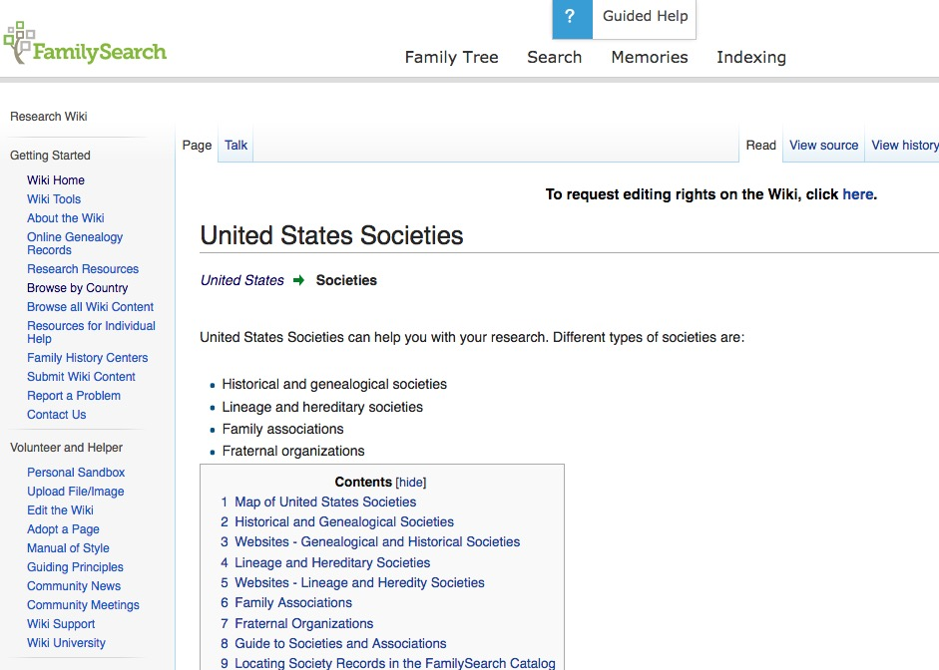
Use the FamilySearch Wiki to locate other societies

Slide 29
Continue to Learn: Conferences
Conferences you might consider:
Lansing Family History Center Seminar (April 28, 2018) http://lansingfhc.org/
NGS Conference in Grand Rapids (May 2018) https://conference.ngsgenealogy.org/register/
Abrams Foundation Family History Seminar (July 20-21, 2018) http://seekingmichigan.org/events/2018-abrams-foundation-family-history-seminar
FGS Conference in Fort Wayne (August 2018)

Slide 30
Continue to Learn: Week long Institutes
$ $, Fun, Exhausting, Social….addictive
Pick one topic and study it in depth in courses designed and taught by national experts.
  GRIP (Genealogical Research Institure of Pittsburgh) http://www.gripitt.org/
  SLIG (Salt Lake Institute of Genealogy) https://ugagenealogy.org/aem.php?eid=36
  IGHR (Institute of Genealogy & Historical Resources) http://ighr.gagensociety.org/
  FedGen (Genealogical Institute on Federal Records) http://www.gen-fed.org/

Slide 31
Use Nearby Libraries
GSWC/FHC library in Saline
University of Michigan Library
  Online Research Guide http://guides.lib.umich.edu/genealogy
  Bentley Historical Library (Michigan)
  Clements Library (Americana)
Detroit Public Library
Toledo Public Library
Your own library

Slide 32
Visit the Allen Co. Public Library
Genealogy Center (a.k.a. “Fort Wayne”
Join The Detroit Society for Genealogical Research, Inc. 31st Annual Research Trip: Allen County Public Library Ft. Wayne, Indiana Saturday, June 9,2018 https://dsgr.org/
Visit their web page to learn about what they have and plan a visit on your own. https://www.genealogycenter.org/

